Slide 1
ABC Call Volume Trend Analysis
Rutuja Sawant

Slide 2
Project Description
Customer Experience Team of Company
They are experts who examine data and customer input
Learning about customer journey
Inbound Customer Service: Methodology of attracting and engaging customers
Turn customers into growth engine of your business

Slide 3
Approach
Dataset of inbound phone calls from ABC insurance firm
Calculating average call time
Total volume vs quality of incoming calls
Putting forward necessary staffing schedule for each time period

Slide 4
Tech-stack Used
Microsoft Excel is a spreadsheet application used to manipulate stored data.
Microsoft Excel enables users to identify trends and organize and sort data into meaningful categories
Pivot tables summarize data from a worksheet into a chart.

Slide 5
Insights 1
Average Call Time
High Call time rates between 10 am to 11 am
Call time rates drops after 12pm to 1pm
Again Spikes between 7pm to 8pm

Slide 6
Insight 2
Total Volume vs Number of Calls
High number calls received in 11am to 12pm
Decrease in number of calls after 3pm

Slide 7
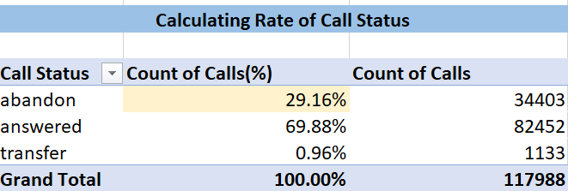
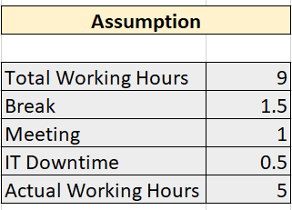
Insight 3
Additional resources required to decrease abandon rate
Current abandon rate is 30 %
An agent works for 5 hours out of 9 hours

Slide 8
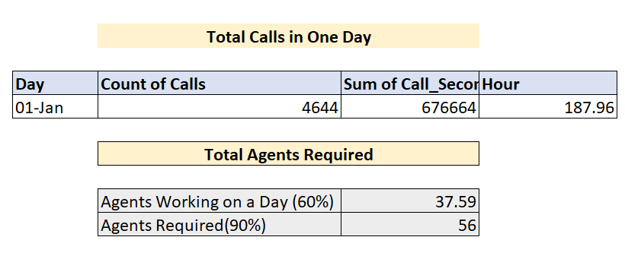
On first day we got 4644 calls for 188 hours
With 38 agents answering rate is 70%
To increase answering rate to 90% we need 56 agents

Slide 9
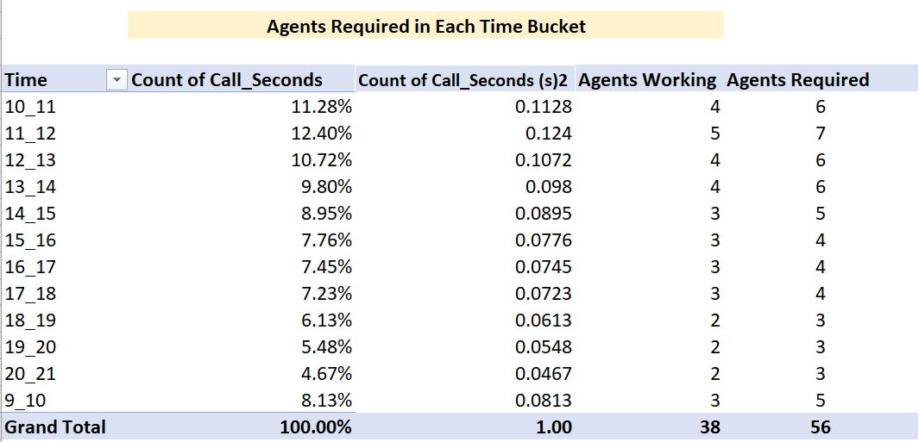
Plan to increase manpower in each time bucket

Slide 10
Calculation
We assumed an agent works for 5 hours daily
In one day all agents works for (sum of call_sec /3600) 187.96~188 Hours
To know Total agents working we are dividing Total working hours/Hours one agents works, i.e. 187.96/5 = 37.59~ 38
To achieve 90% answering rate we need additional resources, and to calculate we are using unitary method
For additional resources [(90*37.59)/60] = 56

Slide 11
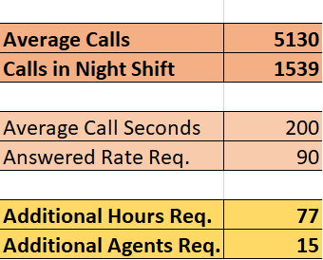
Insight 4
Manpower Plan for Night Shift
Total Calls in month is 117988
Average Calls received in one month is 5130
Total Calls received in night shift is 1539
Average Call Seconds in one month 200 secs
For Better customer experience agency need additional 15 agents for extra 77 hours

Slide 12
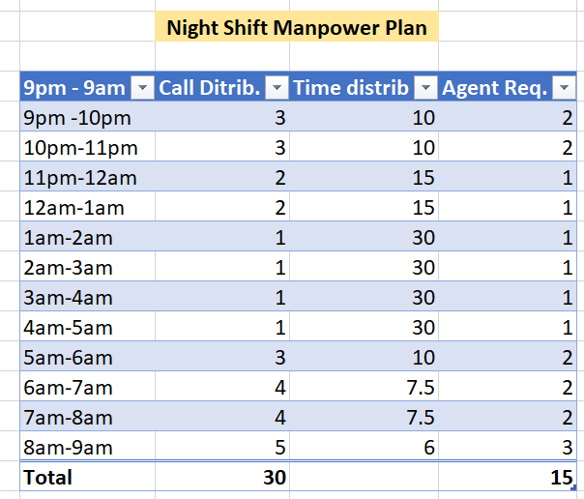
Night Shift Manpower Plan

Slide 13
Calculation
First we calculated Average calls using average excel function
To get number of calls in night we take 30% of average calls i.e. average calls * 30%
To get additional hours of working we are doing following calculation,
Calls in night shift * average call seconds * req. answering rate /3600 = 77 additional hours
To get agents working in additional hours we are dividing ,
additional total hours/ Hours one agent works, i.e. 77/5 = 15
To distribute additional hours in night shift we are dividing,
Total calls in night shift/no of calls in each time bucket [30/3 =10].
To get agents required in each time bucket we are dividing ,
Total agents required/time distribution [15/10 = 2].

Slide 14
Results
Most Traffic of calls is between 11 am to 12 pm.
Most of agents are busy between 10 am to 12 pm.
38 agents works 22 days for 5 hours in a month.
With this working rate abandon rate of calls is 30%.
To reduce abandon rate to 10% agency need total 56 agents.
To improve call quality in night agency need 15 agents to work for additional 77 hours.

